Slide 1


Slide 2
Problem
People need to recall to remove footwear at premises
Religious places
ICU & Hospitals
Server rooms
Dust free zones
Common households

Slide 3
Solution
Make sure that guest to have the shoes out, in a Suttle way
Remind Kids & Husbands to take off their shoes
Leverages safety, IOT acknowledgment of entry & exit of people.
Greets Welcome to guests
Stops Viruses & Bacteria
Makes your home safe & clean.

Slide 4
Value Proposition
Makes life easy, don’t need to bother anyone.
Gives true sense of safety & hygiene
Power efficient.
Provides a technical appeal to the premises.
Count the number of entry and exit.
Easily washable.
Welcomes your guest, a lasting impact.

Slide 5

Specification
Detects & Warn if a person enter with shoes
Welcomes guest
2 Months in 1 charge
Remote audio turn off & on
Detach & Wash
IOT Notification of count, of people stepped on the mat

Slide 6
Unit Economics
Manufacturing cost
Marketing cost
Operations cost
500
300
200
Dealer margin [Industry Standard]
200
Profit
200
Total
1,400
1,699
+ 18 % GST & Shipping

Slide 7
Revenue Streams
Direct Sales
IOT App subscription 199/ Year

Slide 8
Market Size
Hospitals & Medicals
Total 90k ICU wards in India
3% of 90k= 27000
4.35 Crores comfortable and upper middle-class families in India
1% of 4.35 crores= 435000
Families which have small kids and old parents(or In-laws), can use this to ensure their family hygiene, amid covid-19 and other infectious viruses.
Server rooms & Dust free campuses
Total of approx. 12k high security and hygienic buildings and chambers in India(Nuclear power plants, ISRO, DRDO centres, etc.)
10% of 12k= 1200 * 10 = 12,000
Highly hygienic chambers and rooms that are required to keep clean strictly that even dust particles are not allowed in them.
Middle class families' homes
Those big complex hospitals which have well established ICU wards and seeking for good hygienic facilities.

Slide 9
Market validation
Security mats
Cost-7,000
Alarm mats
Cost- 4,000
Halloween ghost mats
Cost- 1,800

Slide 10
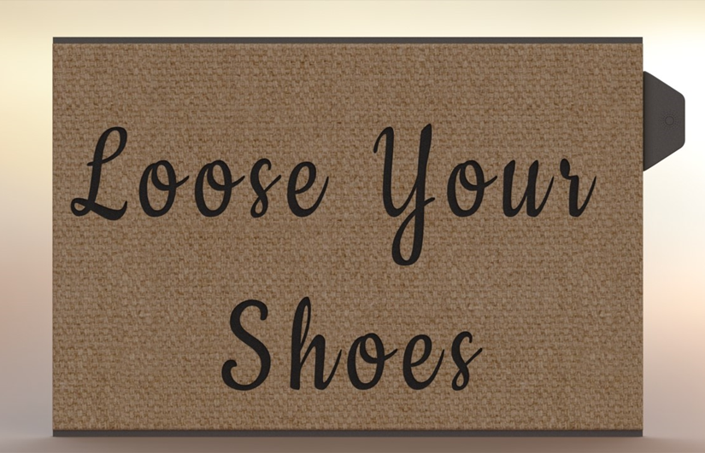
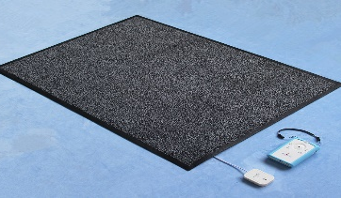
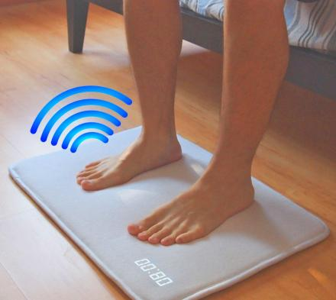
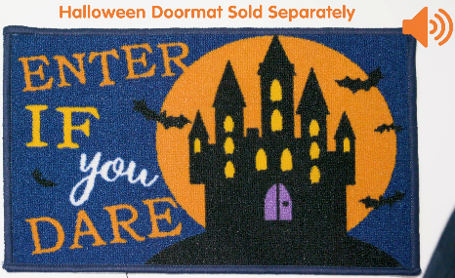
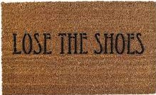
Competition
Intense Security & Utility
Non-Hygienic
Hygiene verified
Mild Secure/Utility

Slide 11
Unique Features & Differentiators
Minimalistic design
Easily washable
Volume control
Warmly welcomes the guest
Enhances security by notification
2 Months in 1 charge.

Slide 12
Current Status
Utility Patent filled & Published
& PCT Application Filled
Branding & Logo Developed
POC done
Product CAD & Simulations done

Slide 13
Team
Kartikey Gupta
Founder
B.Tech, Automobile Engineering.
Filled 5 Utility Patents
Yash Yadav
Co Founder
Indian institute of Technology, Roorkee
Pursuing Bachelor program.

Slide 14
Go to Market
Dealership network with floor mattress showrooms and shops
Big Launching event and good pitching.
Hype on social media and feedbacking of users.
Collaborate with street salesmen to extend the marketing to small levels
Advertisement in medical clinics and health centres.
Collaboration with mattress manufacturers
Magazine publication and newspaper articles
Agents to sell to big hospitals and complex buildings.
Special discount in festive seasons.
Market our product to e-commerce websites.
Contract with hospitals as it increases the hygiene and safety amid corona pandemic.
Collaborate with health ministry to promote hygiene amid covid pandemic.
Online advertisements on various multiuser sites.
Create our own website to ensure users easiness in buying, contacting and feedbacking the product.

Slide 15
Funding
IP Cost
Inventory
Marketing & Content Development
Assembly plant & Office
Tooling & R&D
IOT Platform Development
Team & Operations
Last us for 12 Months
10,000 Units Sales
Revenue 1.4 Crore
199 * 1000 = 1,99,000 [Reoccurring]

Slide 16
Future Perspective
In future, we are planning to couple our smat with the automatic doors, such that the doors will only open iff the smat also gives it the positive command along with the doors itself’s sensors. This vision is extremely useful in the high hygienic and security required chambers such as ICU wards and server rooms.

